Slide 1
Towards a Training Model for Effective Ethical Translation in Health Care Settings in Scotland
Dr Teresa Piacentini
University of Glasgow
LLAS& SCILT 27 April 2012
Notes:
introduction

Slide 2
The Project
GRAMNet Project, funded through the AHRC and SFC.
Interdisciplinary Team: School of Education and the College of Medical, Veterinary & Life Sciences at the University of Glasgow, the School of Health at Glasgow Caledonian University and BEMIS (a non-HE third sector partner).
Project aim: to develop a research-based, pedagogical model for effective translation in intercultural health care settings, using drama and role play.

Slide 3
Project rationale
Multiple factors influence help-seeking behaviour.
Poor communication leads to acknowledged risk of misdiagnosis, medication mismanagement, delay and ineffective service delivery.
Interpreter provision considered key to overcoming barriers to access and effective communication.
Training identified as central to improving communication.

Slide 4
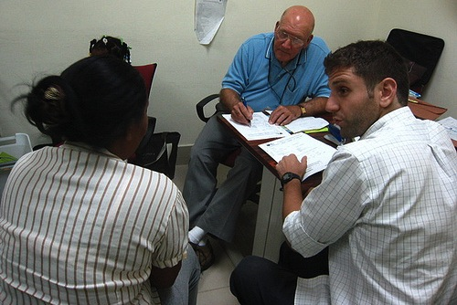
Research methods
Adopting a pedagogically-advised intercultural communication approach to training
Qualitative interviews with
Health care professionals
Interpreters
Migrant service users

Slide 5
Proposed training model
Using practice-informed scenario-based role play and dramatisation as an effective training method for highlighting the different challenges that can arise for all parties where translation occurs in the healthcare
Five workable scenarios to be used in different settings:
trainee clinicians and health care practitioners
trainee interpreters and translators
migrants

Slide 6
5 Key questions to be discussed
What are they key trends?
Practice
Academic
Policy

Slide 7
Practice
Focus on prescriptive guidelines dominates
Overemphasis on interpreter-as-conduit
Conceptualisation of communication and language
Intercultural communication?

Slide 8
Academic research
Moving from interpreting mode to approach
Growing interest in intercultural competence in healthcare settings and interpreting practice
Little dialogue between perspectives
Lack of innovation in research methods
Exceptions: Pasquandrea (2011), TRICC (2011)
Dominant focus on formal healthcare settings

Slide 9
Policy in Scotland
Legislation Equality Act (2010), Disability and ‘Race relations’ legislation (the Disability Discrimination Act 1995 and the Race Relations (Amendment) Act 2000)
Fair for All (Scottish Executive 2001)
Scottish Refugee Integration Forum (2002)
Better Health, Better Care (2007)
NHSGGC Equality Scheme (2009)
NHSGGC Communication and Support Language Plan (2008/2009)

Slide 10
2. How do these trends ‘translate’ into professional practice as it relates to working with interpreters in healthcare settings?

Slide 11
3. What tensions do these trends reveal between dominant ‘linguistic’ and emergent ‘client-centred’ approaches to interpreting?

Slide 12
Community interpreting:
“The community interpreter has a very different role and responsibilities from a commercial or conference interpreter. She is responsible for enabling professional and client, with very different backgrounds and perceptions and in an unequal relationship of power and knowledge, to communicate to their mutual satisfaction” (Shackman, 1984:18).
“The type of interpreting done to assist those immigrants who are not native speakers of the language to gain full and equal access to statutory services (legal, health, education, local government, social services)” (Collard-Abbas, 1989:81).

Slide 13
4. What developments have occurred in practice-based training to reflect the changing social, cultural and structural contexts in which interpreting and translation in health care settings occurs?

Slide 14
5. In light of these trends, what are the experiences, issues and difficulties facing practitioners, interpreters and service users in health care settings?

Slide 15
Thank you!

